Slide 1
Drafting Emails for Work

Slide 2
1
Advantages and limitations
2
Elements in an email
目 录
CONTENTS
3
Style, structure and content
4
Email etiquette
5
Questions for review

Slide 3
Lead-in
The phenomenally rapid growth of the Internet and its widespread use in business has changed the way in which organizations communicate.
All organizations have Internet access, and most individuals have a personal email address.
Many companies are promoting the use of email for most of—if not all—in-house correspondence, and a great deal of communication with outside organizations also relies on email.
Email is an effective way to communicate. It offers some tremendous advantages, but it is also subject to limitations.

Slide 4
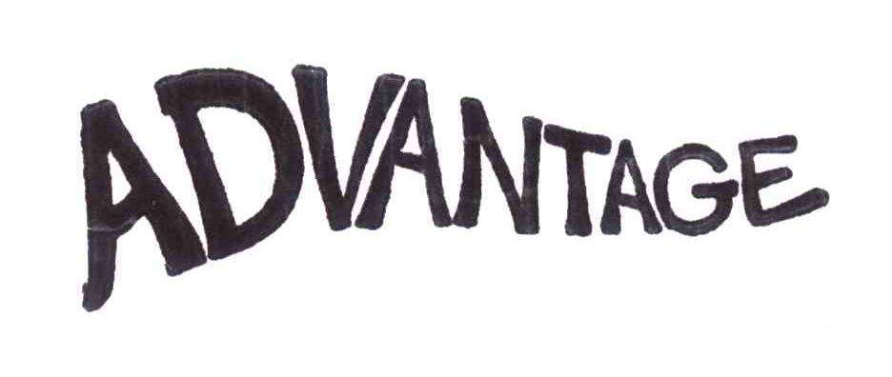
Advantages and Limitations
Discuss in groups and make a list of advantages email offers and limitations it suffers.

Slide 5
Advantages
Email usually reaches its destination instantaneously.
Messages can be sent to as many people as necessary simultaneously. It avoids repetition or reproduction of text.
Email messages can be saved and stored, and one can search message files electronically.
Email systems have a reply button that enables one to include the original message when replying.
Drawings, sounds, video clips, and other computer files can be attached to an email.
One need not worry about interrupting someone when sending an email.
The recipients can read the email at their own leisure and pace and respond after due reflection.
It is inexpensive, as it saves paper and is promoted as a green initiative.

Slide 6
Limitations
Email communication is subject to security issues.
Email is anonymous. The identity of a message’s author can be completely masked or lost in just two generations of the message.
Email cannot be retracted. Once the “Send” button is pressed, there is no bringing it back.
Email is not necessarily private. Since messages are passed from one system to another, there are many opportunities for someone to intercept or read email.
Drawings, sounds, video clips, and other computer files can be attached to an email.
It is possible to forge email. This is not common, but it is possible forge the address of the sender.
We can receive too much or unwanted email, just like other types of junk mail.

Slide 7
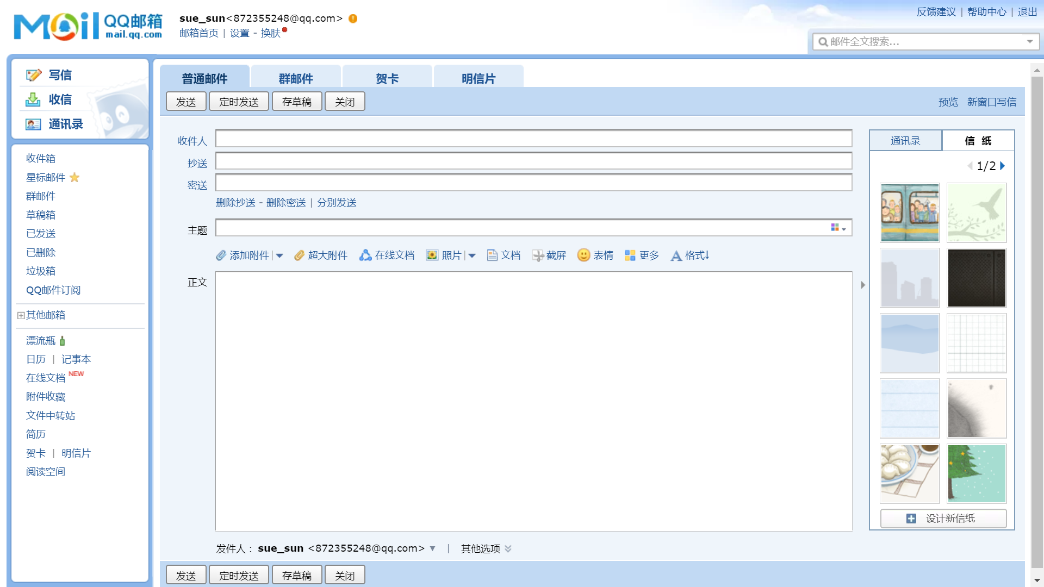
Elements in an email
What elements are there in an email?

Slide 8
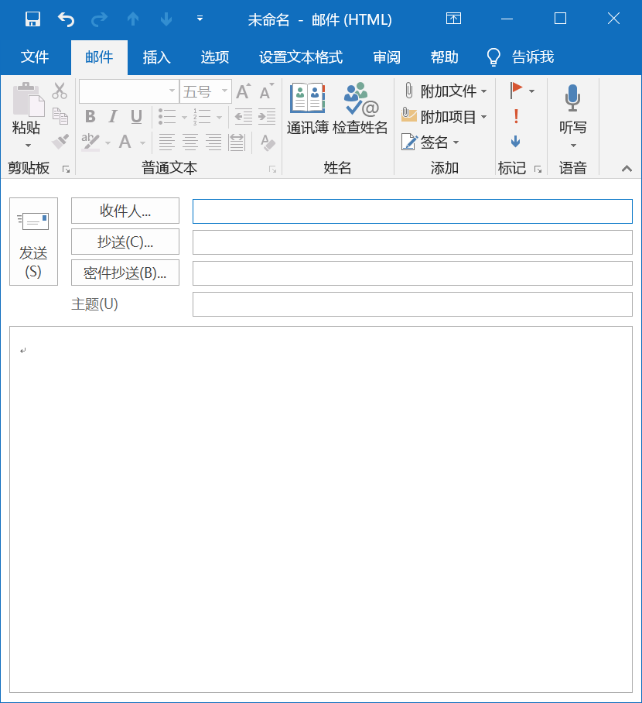
All of your recipients will know you’re sending a copy to this person or group.
None or your readers will know you’re sending a copy to this person or group
To
CC=courtesy/complimentary copy
BC or BCC=blind courtesy copy
Subject
An email should have a specific subject line.
1. Suppose the team leader writes an email to all the members who have to read the mail, in which box should the writer put the members’ address?
2. Suppose the team leader writes an email to the monitor, he/she wants his/her members to know this, but he doesn’t want the monitor and his/her members to know that he/she also sends the email to the teacher, in which box should the writer put the monitor, his/her members and the teacher respectively?
To: All Members
To: Monitor
CC: All Members
BCC: Teacher

Slide 9
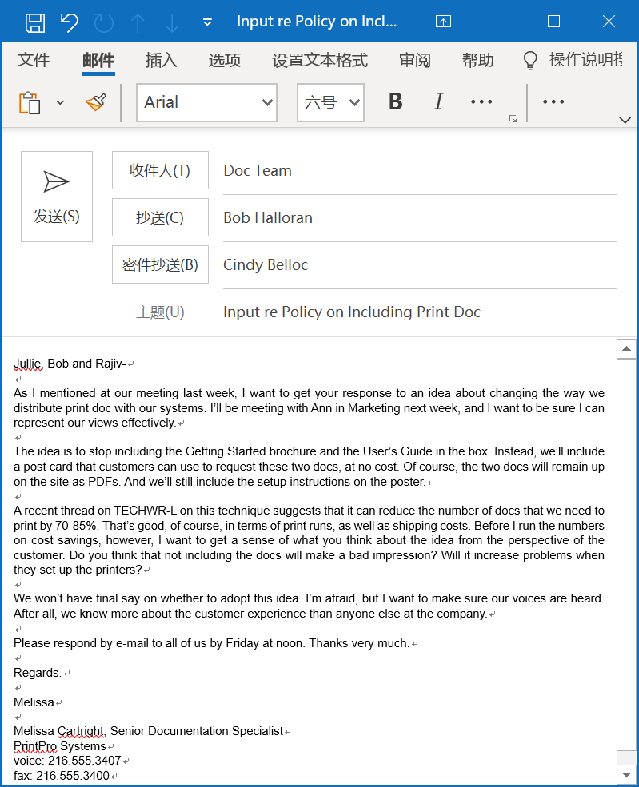
By naming her readers, the writer is showing respect for them.
Heading
The first paragraph clarifies the purpose of writing the email.
The middle paragraphs describe the details.
Paragraphs are relatively brief and double-spaced.
The writer explains what she would like her readers to do.

Slide 10
Style, Structure, and Content
From: To: Cc: Bcc: Sent: Subject: Attachment:
Email messages must be kept brief; ideally, under 200 words.
The tone, i.e. the audience and purpose of the email, should be carefully considered.
Poor spelling and grammar in email messages could lead some readers to question the writer’s competence.
Always take the time to consider the effect that the tone, style, grammar, and spelling of a mail may have on the recipient.
Header
salutation
Body
message
close
Name
Office title
Address
Phone number
signature
signature block

Slide 11
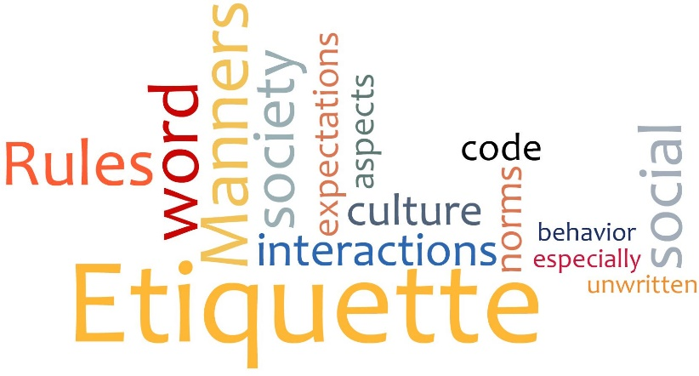

Email etiquette
Stick to business
Write correctly
Use proper spelling, grammar, and punctuation
Use appropriate formality
Use proper structure and layout
Identify yourself and the topic
Be careful with formatting
Be concise and to the point
Do not write in CAPITALS
Avoid long sentences
Use active instead of passive voice
Keep the language gender-neutral
Maintain coherence
Re-read the email before sending it

Slide 12
Answer swiftly
Do not overuse Reply All
Answer all questions, and pre-empt further questions
Use templates for frequently used responses
Be kind. Do not flame.
Do not overuse the high priority option
Do not attach unnecessary files
Do not use email to discuss confidential matters
Avoid using URGENT and IMPORTANT
Take care with abbreviations and emoticons
Do not reply to spam
Don’t forward a message to an online discussion forum without the writer’s permission
Don’t send a message unless you have something to say
Notes:
preempt: to cause to have no influence or force by means of taking action in advance抢在…之前行动；预先制止

Slide 13

Level of formality
the frozen style
the formal style
the consultative style
the casual style
the intimate style
庄严体
正式体
商议体
随意体
亲密体

Slide 14
Read and Decide
1) My dear father has just expired.
2) My old man just kicked the bucket.
3) My dad has died.
4) My beloved parent has just passed to his heavenly reward.
5) My father has just passed away.
--- by Martin Joos
Frozen Formal Consultative Casual Intimate
( ) ( ) ( ) ( ) ( )
4
1
5
3
2

Slide 15
Read and Decide
Our meeting with United went south right away when they threw a hissy fit, saying that we blew off the deadline for the progress report.
In our meeting, the United representative expressed concern that we had missed the deadline for the progress report.
It was indubitably the case that our team was successful in presenting a proposal that was characterized by quality of the highest order. My appreciation for your industriousness is herewith extended.
I think we put together an excellent proposal. Thank you very much for your hard work.
too informal
too formal
Notes:
go south <美口>下跌；减弱；下降；退步 to have a hissy fit 发脾气 blow off: to refuse to take notice of, honor, or deal with : ignore; to end a relationship with

Slide 16
you attitude vs. we/me attitude
多用你方态度(you-attitude)，少用我方态度(we/me-attitude)
Correspondence must convey a courteous, positive tone. The key to accomplishing this task is using the “you attitude” — that is, looking at the situation from the reader’s point of view and adjusting the content, structure, and tone to meet his or her needs.
Put yourself in your reader’s shoes
Try to imagine what your reader will feel about what you write
Reflect and emphasize your reader’s needs, interests and concerns
Protect your reader’s ego

Slide 17
Read and Decide
You must have dropped the engine. The housing is badly cracked.
The badly cracked housing suggests that your engine must have fallen onto a hard surface from some height.
accusing
You’ll need two months to deliver these parts? Who do you think you are, the post office?
Surely you would find a two-month delay for the delivery of parts unacceptable in your business. That’s how I feel, too.
sarcastic

Slide 18
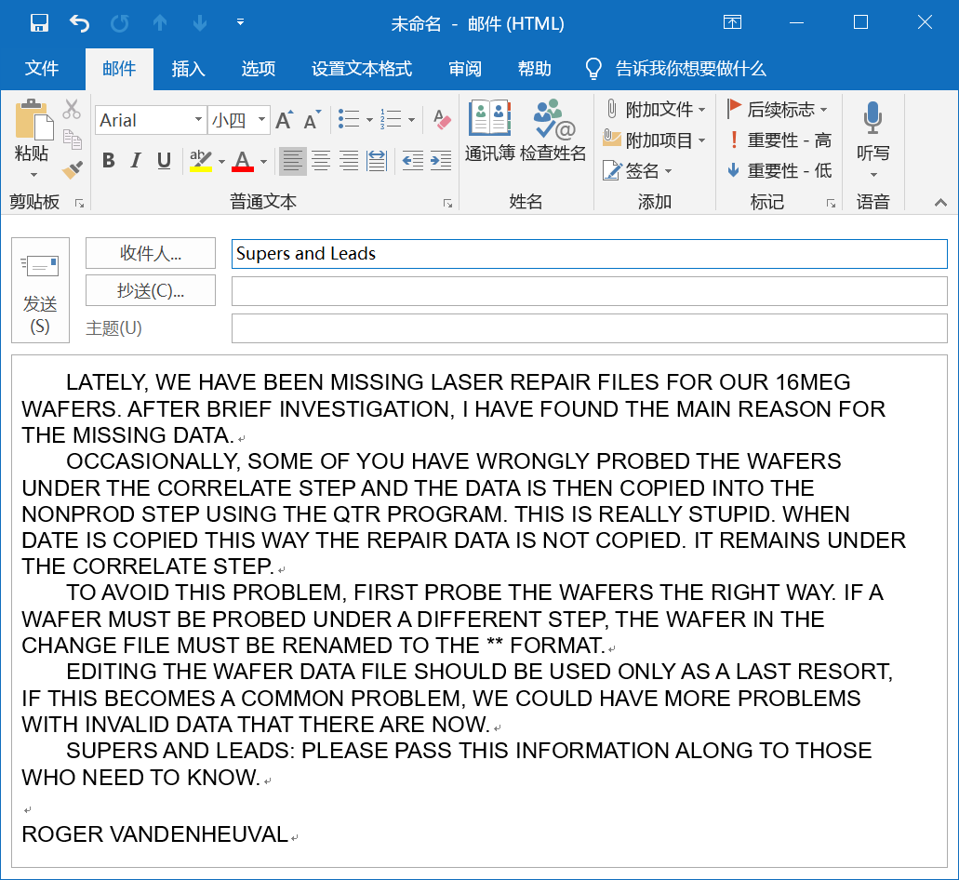
Comment on the following email
The messages are written in capital /uppercase letters.
It is difficult to read.
It appears as if the writer is yelling at his/her reader(s).

Slide 19
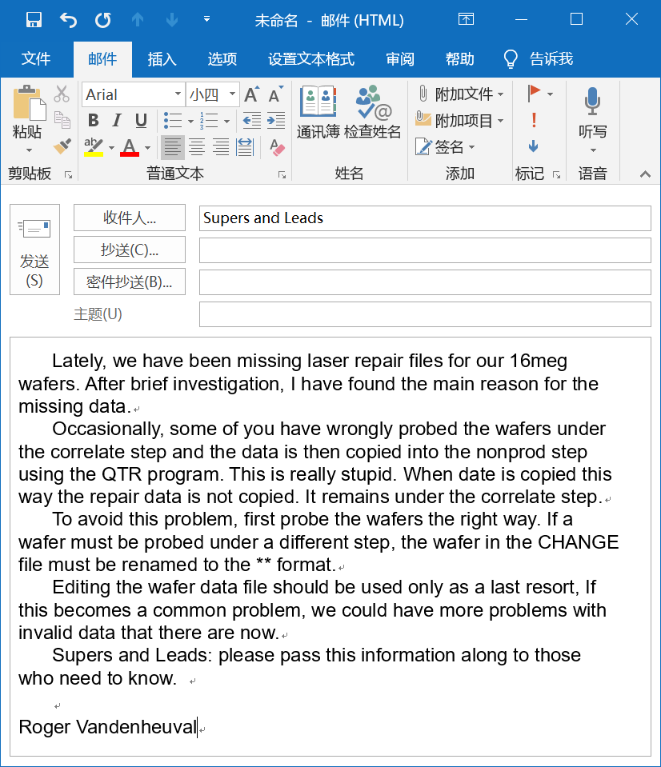
The writer does not state his purpose in the subject line and the first paragraph.
Salutation is not written.
The writer’s tone is hostile.
The writer has not proofread it.
The writer does not conclude politely.

Slide 20
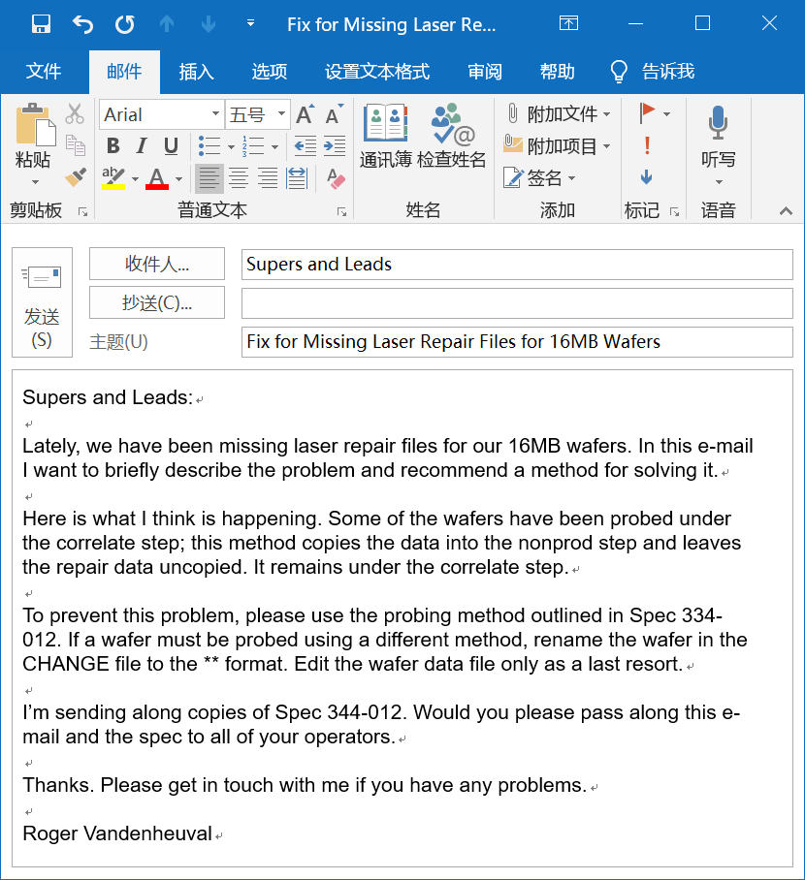
The subject line and first paragraph clearly state the writer’s purpose.
Double-spacing between paragraphs makes the e-mail easier to read.
The writer concludes politely.

Slide 21
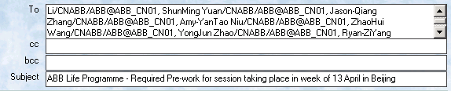
Read, comment and revise
Jack
What is the matter with this email?
Monthly report for April
My dear,
I have been told that the monthly report for April should be submitted by you before this Friday.
I remember that you have been told about the deadline and how to prepare for the report.
If you have any questions, I don’t mind to be interrupted any time.
BR,
Lily Zhu

Slide 22
Jack
Instead of using “My dear”, it is more appropriate to address the recipient's name “Dear Jack”
Monthly report for April
My dear,
I have been told that the monthly report for April should be submitted by you before this Friday.
I remember that you have been told about the deadline and how to prepare for the report.
If you have any questions, I don’t mind to be interrupted any time.
BR,
Lily Zhu
Overuse of passive voice sounds really odd and may create misinterpretation.

Slide 23
Jack
Monthly report for April
Dear Jack,
I am writing to let you know that the deadline for April monthly report is this Friday.
I trust you are well aware of the time frame and how to prepare for the report.
However, if you need any support, please feel free to contact me any time.
Best regards,
Lily Zhu
It sounds much more professional.

Slide 24
Questions for review
Did you refrain from discussing nonbusiness subjects?
Did you keep the e-mail as brief as possible and send it only to appropriate people?
Did you use appropriate formality?
Did you write correctly?
Did you avoid flaming?
Did you write a specific, accurate subject line?
Did you use uppercase and lowercase letters?
Did you skip lines between paragraphs?
Did you keep the line length under 65 characters?
Did you check with the writer before forwarding his or her message?

Slide 25
Thank You for Attention！

